Slide 1
Speaking Data: The Language of Impact and Behavior Change
The AI-powered human process of turning data into actionable insights

Slide 2
Scenario
Assuming your company is having “challenges” with AI adoption. Senior leadership wants you to solve this by rolling out a mandatory training program for everyone.

Slide 3
Scenario: AI Adoption Gap Survey
Stakeholders wanted mandatory training for all
But, agreed to run a survey to sample the AI adoption gap first.

Slide 4
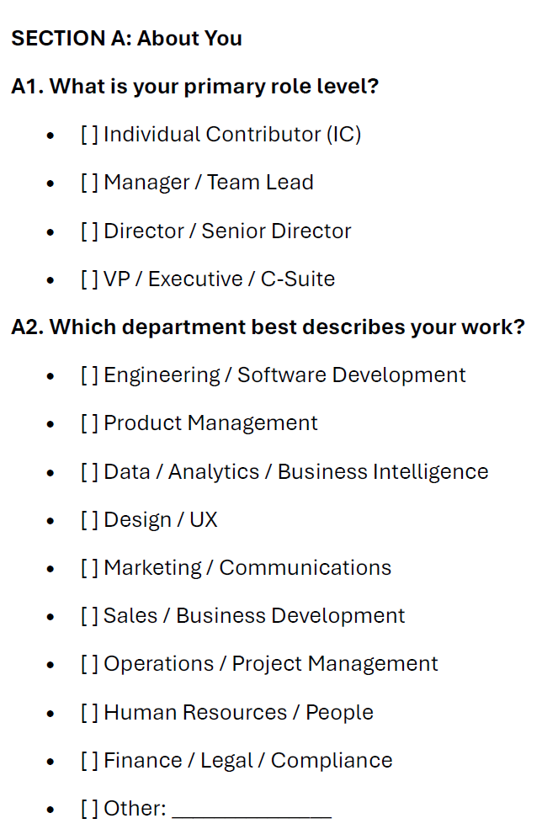
AI Adoption Survey
(demographics)

Slide 5
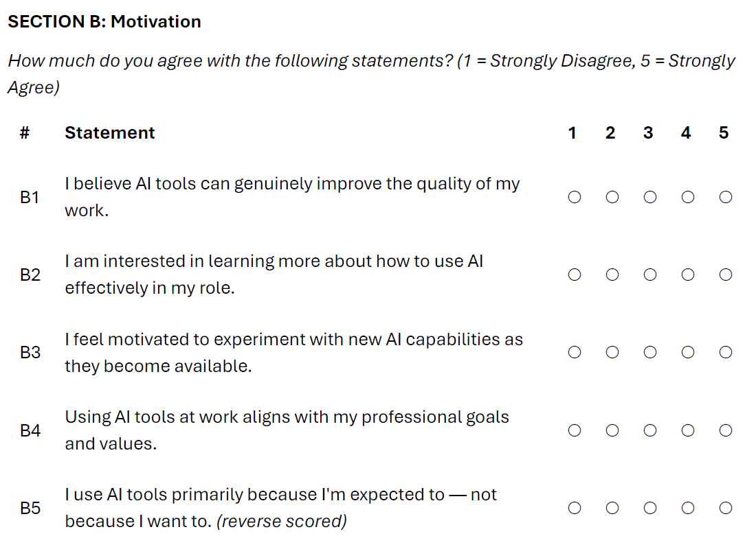
AI Adoption Survey
(Likert scale)

Slide 6
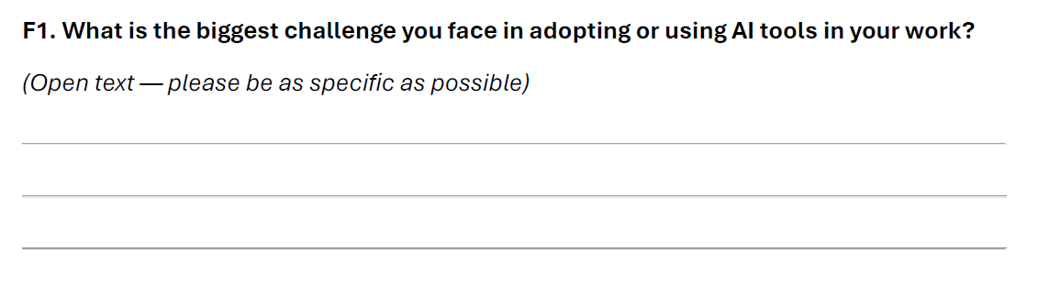
AI Adoption Survey
(open-text)

Slide 7
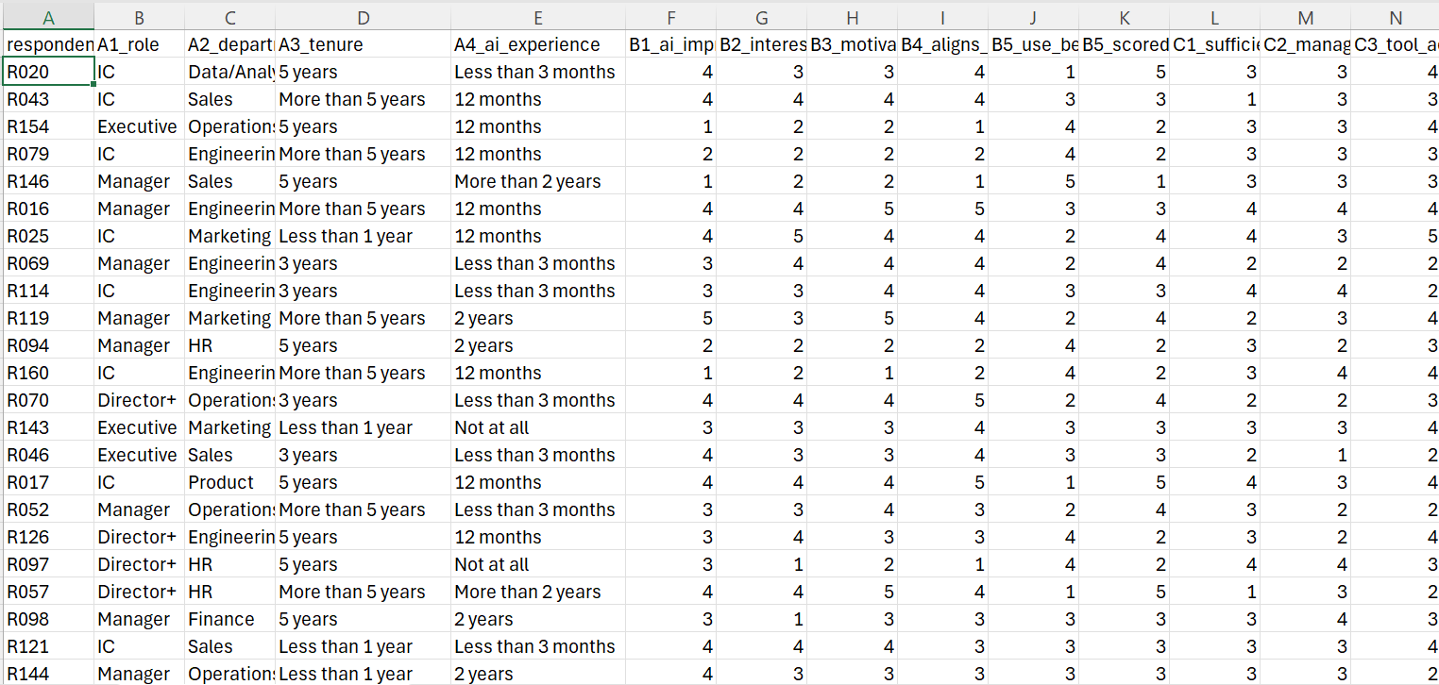
AI Adoption Survey
(raw data)

Slide 8
How to report out the survey results?
Individual questions
Averages on Likert
Summary of open-text
AI summary of raw data
AI recommendations of actions
Quantitative data insights
Response patterns
Actionable recommendations based on responses
A) Human-only
B) AI only
C) AI-Powered Human

Slide 9
Human-Only Approach
Requires expertise, resources, and tools. Time-consuming but predictable.

Slide 10
Survey Results (usual reporting)
You’ve surveyed the organization about AI adoption. The data is in. Your stakeholders expect a report.
3.2
3.0
2.9
2.7
Motivation
Opportunity
Job Capability
Outcome
Moderate — seems okay
Neutral — watch this
Below midpoint
Low — concerning?

Slide 11
Survey Results (usual reporting)
You’ve surveyed the organization about AI adoption. The data is in. Your stakeholders expect a report.
3.2
3.0
2.9
2.7
Motivation
Opportunity
Job Capability
Outcome
Moderate — seems okay
Neutral — watch this
Below midpoint
Low — concerning?
What these numbers hide:
A score of 3.2 on Motivation could mean everyone feels mildly positive — OR 35 people are deeply disengaged and 30 are intrinsically motivated. These two realities require completely different interventions. The average erases the difference.

Slide 13
AI-Only Approach
Quick, simple, and sometimes it may even be accurate. Except, it’s not deterministic.

Slide 14
Survey Results (AI raw data)
Can I ask AI to be “deterministic?” – Replicability: same prompt, same answer.
Claude says:
“Determinism in LLM outputs comes from narrowing optionality, not from asking for determinism by name. The more you specify what I cannot do, the more consistent the output becomes.”

Slide 15
Survey Results (AI raw data)
Can I ask AI to be “deterministic?” – Replicability: same prompt, same answer.
Example prompt: “Analyze the attached survey data using only the information provided. Do not infer, assume, or fill in gaps. For each finding, cite the specific column/question it comes from. Flag any data quality issues you encounter. Present results as: (1) summary statistics, (2) key patterns, (3) limitations. Do not draw conclusions beyond what the data directly supports."

Slide 16
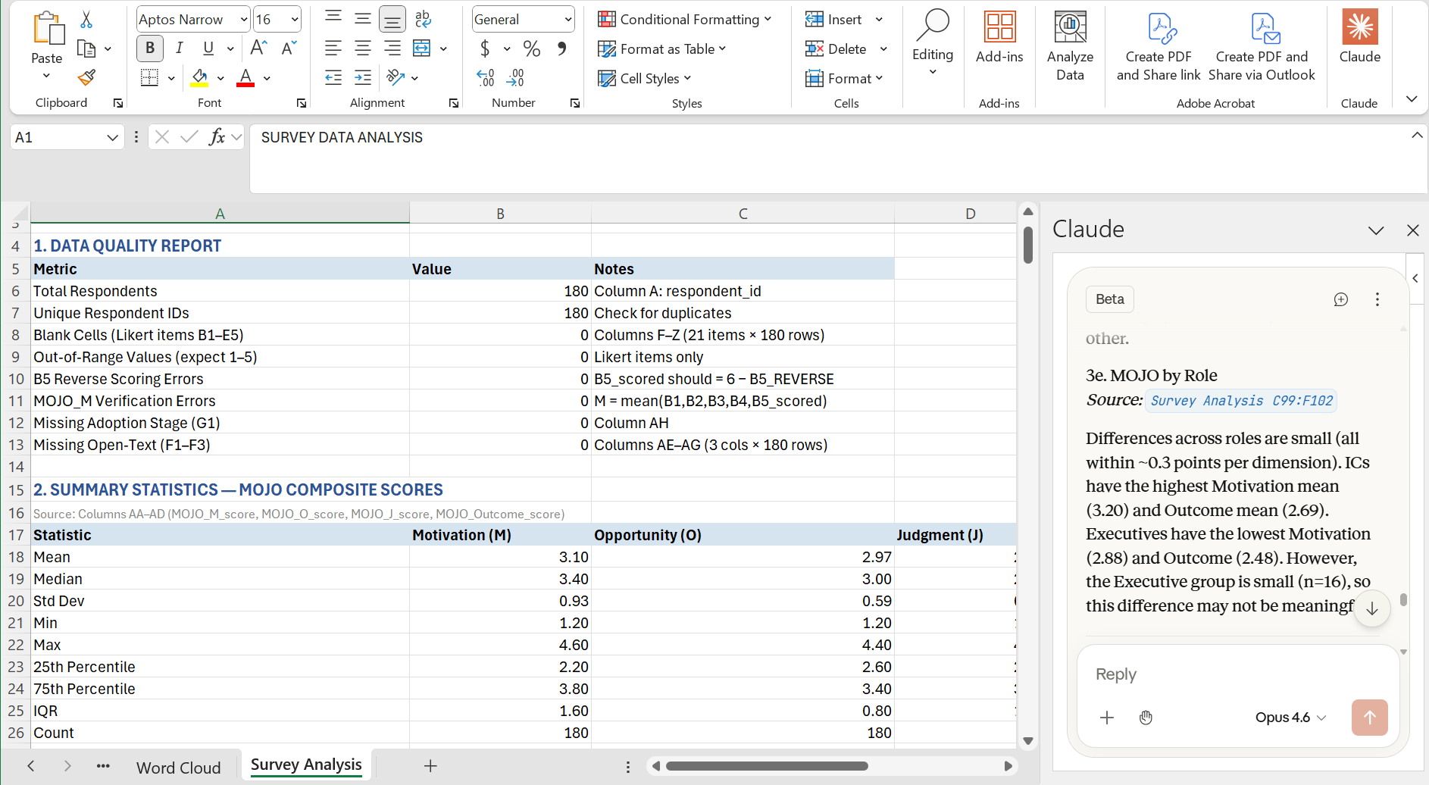
In-Excel Results
Built-in Copilot or Claude inside Excel can provide the results instantly.

Slide 17
AI-Powered Human Approach
Shifting AI’s role from “black box” pattern recognition to pattern description.

Slide 18
AI + HUMAN approach
Finding actionable patterns in survey data
How to turn a standard employee survey into differentiated, evidence-based guidance your stakeholders will actually act on.
1
2
3
4
Component Pattern Analysis (CPA)
Non-negative Matrix Factorization (NMF)
MOJO Framework
Self-Determination Theory
Universal Steps
Org Specific Steps

Slide 19
What stakeholders
usually get:
What we'll do instead:
01
Discover who has similar response patterns — not just averages (quantitative)
A slide deck of bar charts
Response rate percentages
02
Identify what those groups are saying (qualitative)
Top-box scores by department
03
Map patterns to behavioral drivers (MOJO)
A list of lowest-rated items
04
Connect to motivation stage (SDT)
"Key themes" from a word cloud
05
Generate interventions specific to each group
None of this tells you what to do — or for whom.

Slide 20
Today's Journey
Four steps from raw survey data to differentiated action
1
2
3
4
Design &
Collect
Component
Pattern Analysis
NMF Topic
Modeling
Profiles +
Recommendations
→
→
→
MOJO-aligned survey
28 questions, 4 dimensions
PCA + K-Means
Find quantitative clusters
Open-ended text
5 qualitative themes
MOJO × SDT
Differentiated guidance
Today's dataset: 180 simulated employee responses · Tech company · AI adoption survey

Slide 21
The Survey: Built Around MOJO
Each section measures a distinct behavioral dimension
M — Motivation
Do they WANT / PLAN to?
J — Job Capability
Are they ABLE?
• I believe AI can improve the quality of my work
• I feel confident using AI effectively
• I'm motivated to experiment with new AI capabilities
• I know how to write prompts that get results
• Using AI aligns with my professional values
• I can critically evaluate AI-generated output
Can they ACT / PRACTICE?
Will / Did it WORK?
O — Opportunity
Outcome
• I have sufficient time to explore AI tools
• AI tools have meaningfully improved my productivity
• My manager actively supports AI use
• I can point to specific situations where AI helped
• I have access to the tools I need
• My team has benefited from AI adoption
+ 3 open-ended questions (for NMF) · 1 adoption stage item · 28 questions total · ~8 min to complete

Slide 22
Moving from averages to…
Patterns across Likert questions grouped/clustered.
3.2
3.0
2.9
2.7
Motivation
Opportunity
Job Capability
Outcome
Moderate — seems okay
Neutral — watch this
Below midpoint
Low — concerning?
How many clusters (response patterns) are there?
What determines those clusters (which questions)?
Who are in those clusters?

Slide 23
Step 2: Component Pattern Analysis (CPA)
Two algorithms working together to find who thinks alike
Principal Component Analysis (PCA)
K-Means Clustering
What it does
What it does
• Takes 20 Likert items (20 dimensions)
• Groups respondents with similar answer patterns
• Compresses them into 2 dimensions that preserve the most variance
• No pre-defined categories — the data reveals the groups
• Reveals the main axes of variation in how people answered
• 5 clusters selected to match expected behavioral diversity
• Implemented here via numpy's SVD — no black box
Think of it as a map of the response space
Think of it as finding natural neighborhoods on the map
Together: PCA reduces noise; K-means finds the clusters. Neither algorithm needs to know about personas in advance.

Slide 24
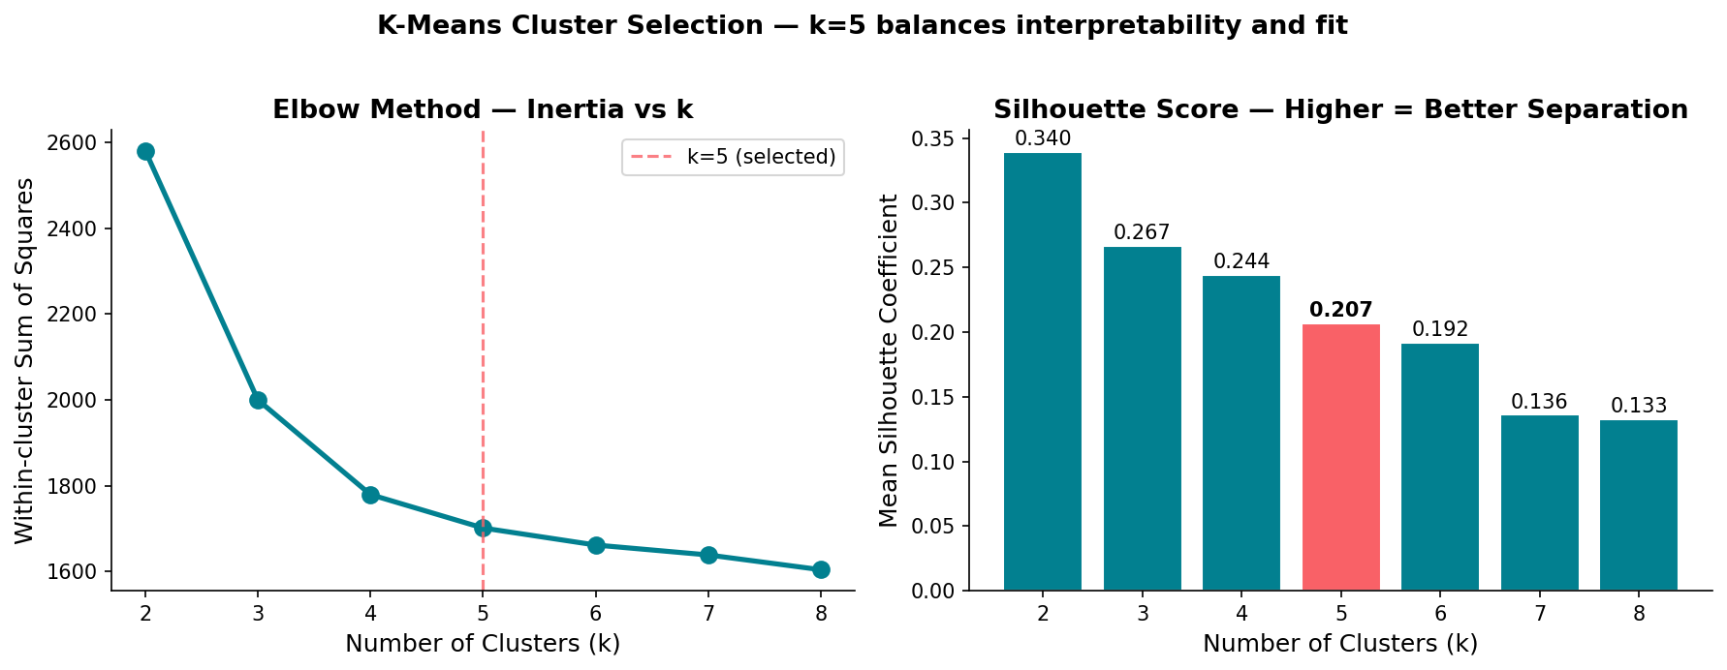
Choosing k — Elbow Method + Silhouette Score
Two independent signals both point to k = 5 clusters
Elbow: inertia drops sharply from k=2→5, then flattens — diminishing returns beyond 5. Silhouette: peaks at k=2 (natural split) but k=5 retains meaningful structure. Domain knowledge (5 behavioral profiles expected) confirms the selection.

Slide 25
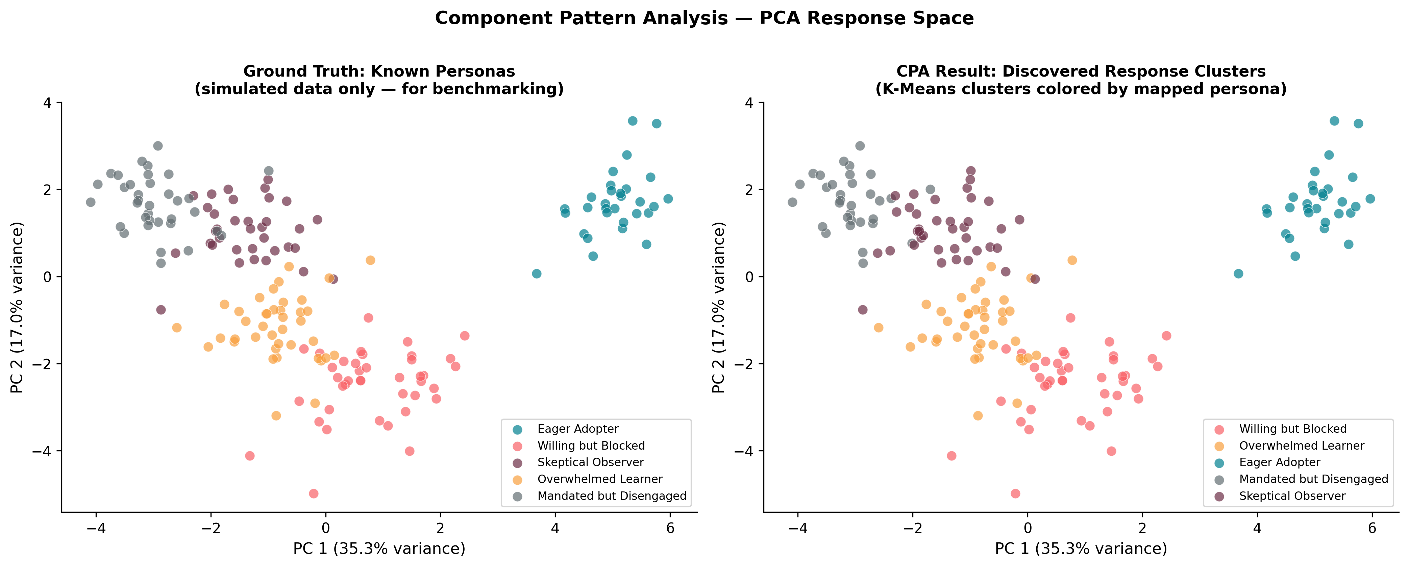
Pattern Analysis: What the Algorithm Found
5 distinct response clusters emerge naturally from the data
Left: ground truth personas (simulated data only) · Right: what you'd see with real survey data — clusters emerge without labels

Slide 26
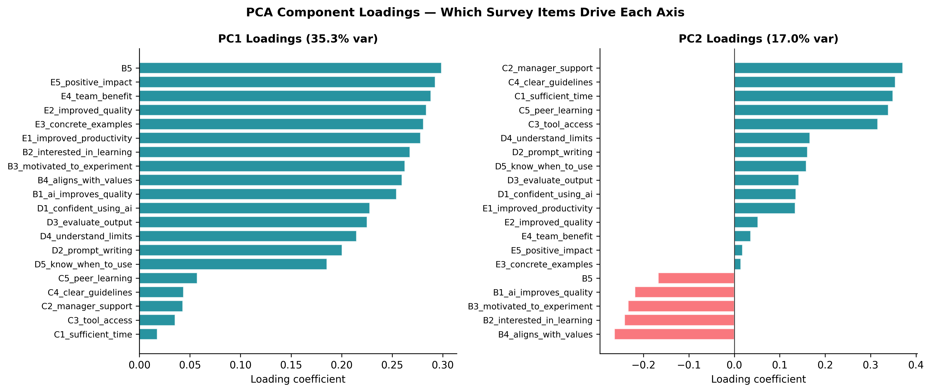
What Drives the Clusters?
PCA component loadings reveal which survey items separate people most in the component.
Items with large loadings are the 'forks in the road' — the questions where people's answers diverge most. These are often more actionable than items everyone agrees on.

Slide 27
What Might Be These Components Represent?
PCA does not name or describe the clusters. It’s a human job.
VALUE & RESULTS
EXTERNAL
INTERNAL
Outcome Focus (value/results) vs. Motivation (extrinsic to intrinsic)

Slide 28
Qualitative Data
How do we analyze open-text comments?

Slide 29
Step 3: What Are They Actually Saying?
Non-Negative Matrix Factorization (NMF) — topic modeling for open-ended text
Open-Ended
Responses
TF-IDF
Matrix
NMF
Factorization
Topic
Themes
→
→
→
3 text questions
180 respondents
Terms × documents
Keyword weights
V ≈ W × H
Non-negative parts
Each respondent gets
a dominant topic
Why NMF (not just a word cloud)?
Topics are interpretable: every word adds positively — no canceling out
Each person gets a dominant topic weight — not just a frequency count
Connects directly to MOJO: we can see which clusters have which theme

Slide 30
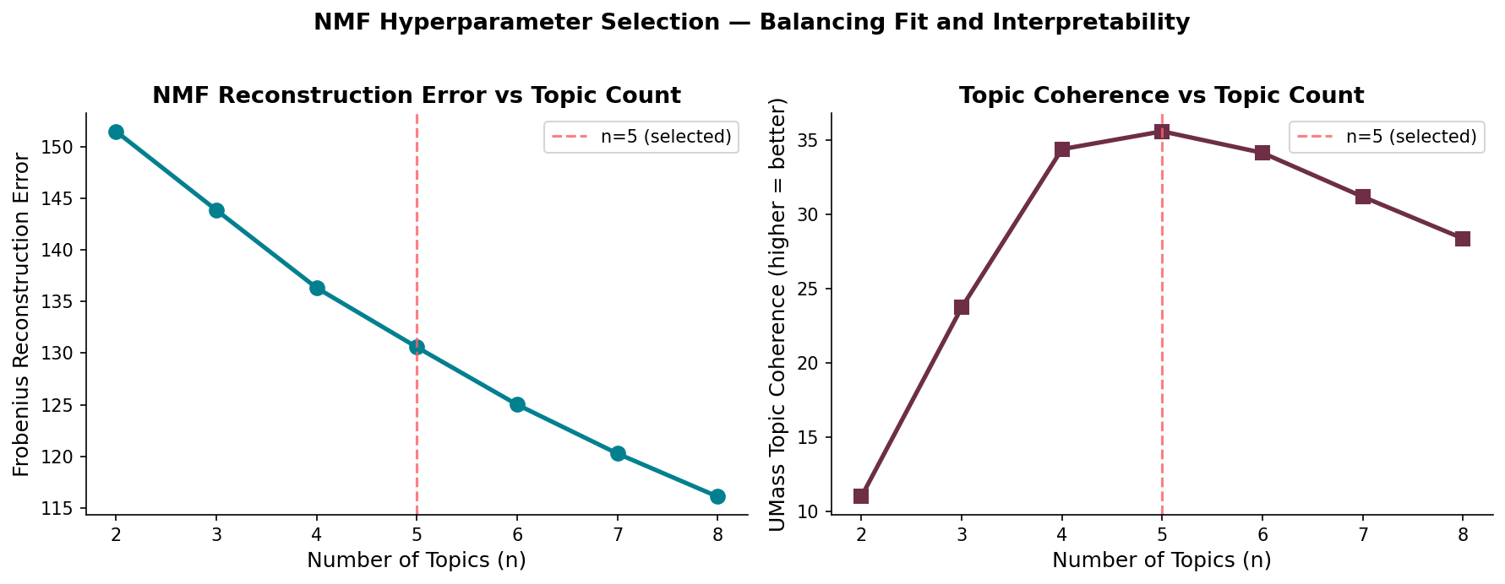
Choosing the Number of Topics
Reconstruction error and coherence both suggest 5 topics is optimal
Reconstruction error (Frobenius norm): measures how well NMF approximates the TF-IDF matrix — lower is better. Coherence (UMass): measures how often top words co-occur in the corpus — higher is more interpretable. n=5 balances both: error plateaus, coherence peaks.

Slide 31
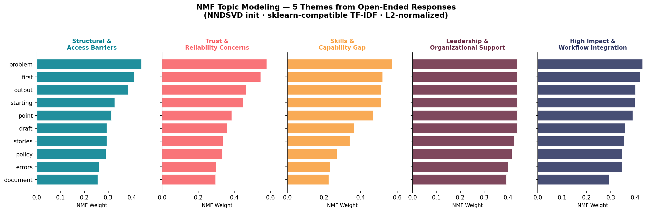
NMF: 5 Themes from Open-Ended Text
Naming and describing themes using AI.
AI’s role: shifted from pattern recognition (open and unpredictable) to pattern description (deterministic).
Naming and describing the themes is an AI + Human job.

Slide 32
NMF: 5 Themes from Open-Ended Text
The algorithm identified these themes without being told what to look for
Each bar chart shows the top 8 words driving that topic · Interpretations come from reading these patterns — not from pre-labeling

Slide 33
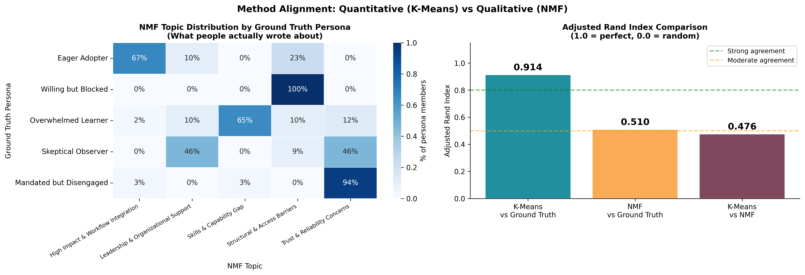
Do Both Methods Agree?
Adjusted Rand Index (ARI) measures convergent validity across the two analytical lenses
K-Means ARI: 0.914
NMF ARI: 0.510
Method
Agreement: 0.48+

Slide 34
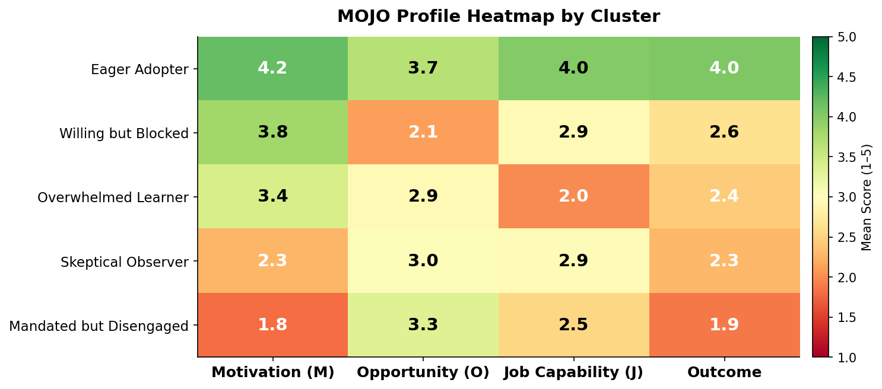
Response Patterns vs. MOJO
One heatmap replaces 20 bar charts — and tells a clearer story
Key insight: 'Willing but Blocked' scores 3.8 on Motivation but 2.1 on Opportunity. More training won't move them. Removing barriers will.

Slide 35
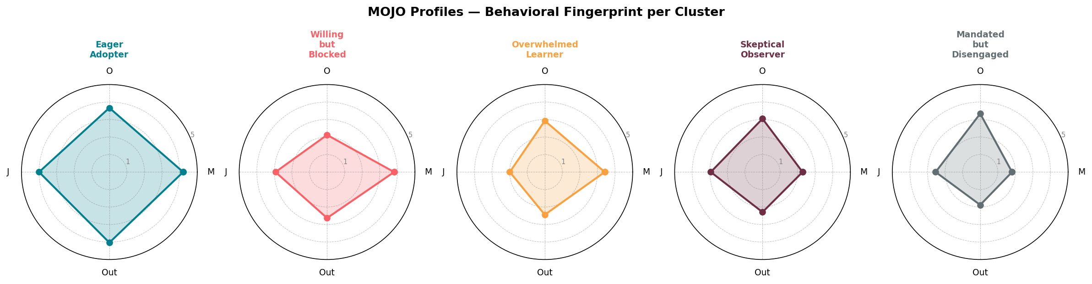
MOJO Profiles at a Glance
Radar charts show the behavioral 'fingerprint' of each cluster
Eager Adopter: Full radar — constrained only by Opportunity
Willing but Blocked: High M, collapsed O — structural fix needed
Mandated but Disengaged: Flat on M — motivation is the only lever

Slide 36
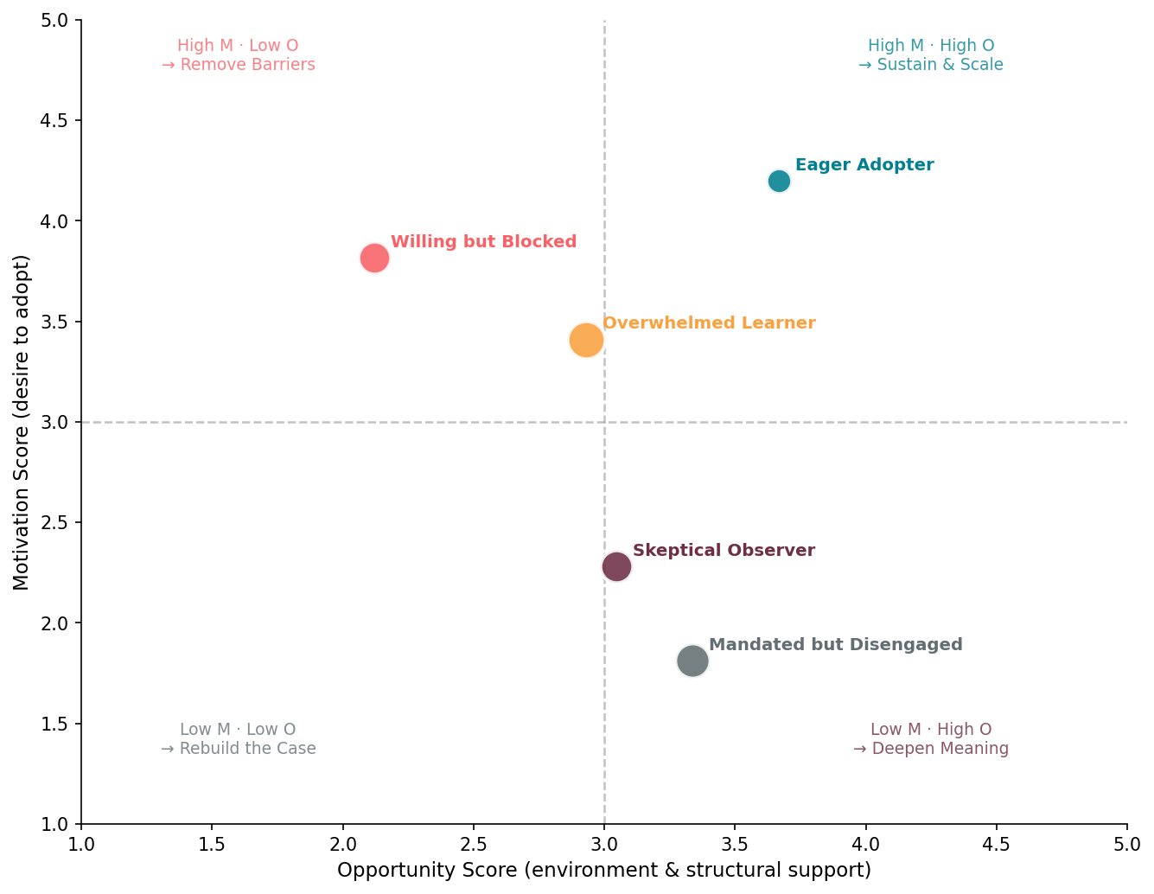
What now? Action Priority Matrix
Where should resources go first? MOJO gives us the answer
High M + Low O
Action: Remove Barriers
Willing but Blocked — structural fix. Policy, tools, time.
High M + High O
Action: Sustain & Scale
Eager Adopters — give them advanced pathways and community.
Low M + Low O
Action: Rebuild the Case
Skeptical Observers — show evidence. Build trust, not access.
Low M + High O
Action: Deepen Meaning
Mandated but Disengaged — invite, don't mandate. Meaning first.
Bubble size = capability gap. Larger bubbles need training investment alongside structural/motivational change.

Slide 37
What now? Action Priority Matrix
Where should resources go first? MOJO gives us the answer
High M + Low O
Action: Remove Barriers
Willing but Blocked — structural fix. Policy, tools, time.
High M + High O
Action: Sustain & Scale
Eager Adopters — give them advanced pathways and community.
Low M + Low O
Action: Rebuild the Case
Skeptical Observers — show evidence. Build trust, not access.
Low M + High O
Action: Deepen Meaning
Mandated but Disengaged — invite, don't mandate. Meaning first.
Bubble size = capability gap. Larger bubbles need training investment alongside structural/motivational change.

Slide 38
A Word on Motivation
Not as simple as it seems…

Slide 39
Self-Determination Theory
The Motivation Spectrum
External — Complying to avoid consequences
Introjected — Acting to avoid guilt/shame
Identified — Sees personal value in doing it
Integrated — Adopting it as part of professional identity
Intrinsic — Genuinely enjoying the activity

Slide 40
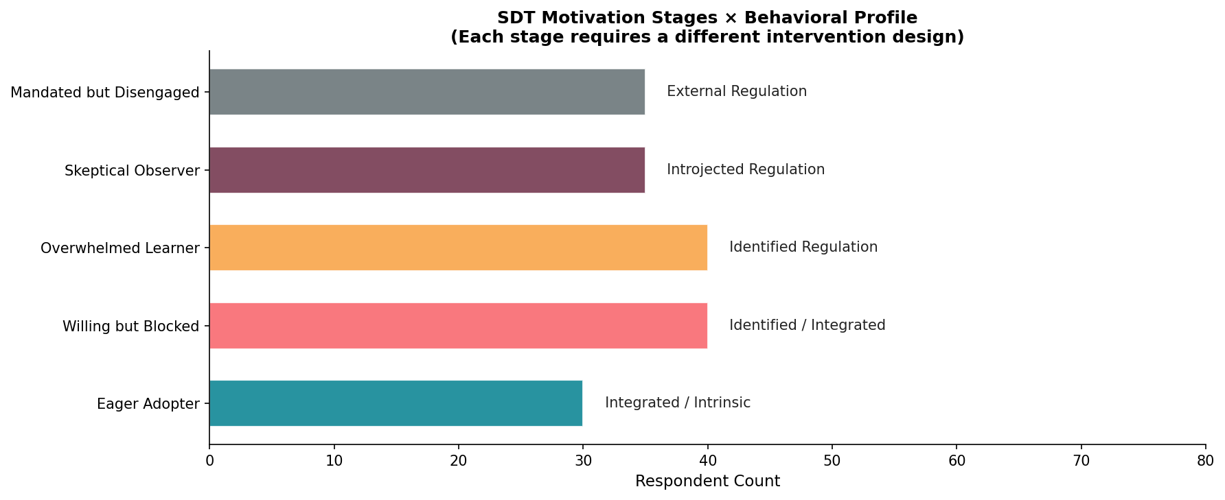
Why Motivation Type Matters
Self-Determination Theory: not all motivation is equal
The Motivation Spectrum
External — Complying to avoid consequences
Introjected — Acting to avoid guilt/shame
Identified — Sees personal value in doing it
Integrated — Part of professional identity
Intrinsic — Genuinely enjoys the activity
L&D mistake: designing the same intervention for all stages. Mandated adoption deepens External Regulation — it doesn't move people toward Integrated or Intrinsic.

Slide 41
Differentiated Recommendations
One intervention per profile — matched to MOJO gap and SDT stage
Eager Adopter
Advanced communities of practice · Fast-track AI policy approvals · Peer showcase opportunities
n=30 · SDT: Integrated · Gap: Opportunity
Willing but Blocked
Protected learning time (1hr/wk) · Published approved tool guide · Coach managers to model AI use
n=40 · SDT: Identified · Gap: Opportunity
Overwhelmed Learner
Role-specific AI starter kits · Peer mentoring with Eager Adopters · Short-format 10-min practice videos
n=40 · SDT: Introjected · Gap: Job Capability
Skeptical Observer
Domain-specific evidence · Transparent AI evaluation criteria · Low-stakes voluntary pilot programs
n=35 · SDT: External · Gap: Motivation (belief)
Mandated but Disengaged
Shift to invitation over mandate · Connect to outcomes they care about · Co-design the rollout with them
n=35 · SDT: External · Gap: Motivation (meaning)

Slide 42
The Business Case for Pattern Analysis
What you gain when you stop treating 5 populations as one
Without: One training program for all employees
→ Budget efficiency — don't train people who are already capable
With: Role-specific kits for Overwhelmed Learners (n=40) who actually need skills
Without: Expand AI tool access company-wide
With: Target access improvements to Willing but Blocked (n=40) with high motivation
→ Better ROI — Skeptics won't use access they distrust
Without: Send another 'AI adoption is important' all-hands message
→ Trust — mandates deepen disengagement in this group
With: Engage Mandated but Disengaged through co-design, not mandate
Without: Survey report archived after quarterly business review
→ Action — stakeholders know exactly what to do and for whom
With: Segmented strategy mapped to specific interventions per profile

Slide 43
Run This In Your Organization
The full workflow is replicable with open-source tools
1
2
3
Design the Survey
Collect Data
Run CPA
Map questions to MOJO dimensions. Include 3+ open-ended items. Aim for n≥80.
Standard survey platform. Export to CSV. No special tooling needed.
Python (numpy + pandas). PCA via SVD. K-Means from scratch or sklearn. Notebook provided.
4
5
6
Run NMF
Map to MOJO
Recommend by SDT Stage
TF-IDF on open-ended text. NMF factorization. Label topics based on top words.
Average each MOJO dimension by cluster. Build heatmap. Find the MOJO gap.
Match SDT stage to profile. Design intervention for that motivation level.
All code available in the Jupyter notebook · No specialized ML platform required · Runs on standard Python stack

Slide 44
From Data to Direction
The goal is never analysis for its own sake — it's the decision it enables.
01
Averages mask the variation that makes interventions fail — always look for subgroups
02
CPA reveals who thinks alike without requiring pre-defined categories
03
NMF gives voice to what people are saying — not just what scores they gave
04
MOJO tells you where to focus — motivation, opportunity, capability, or outcome (goals)
05
SDT stage determines HOW you pull that lever — mandate vs. invite vs. showcase

